Slide 1

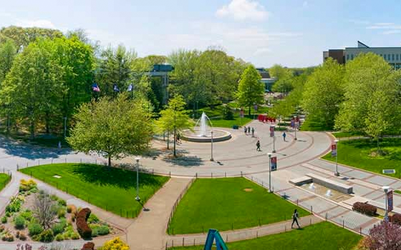
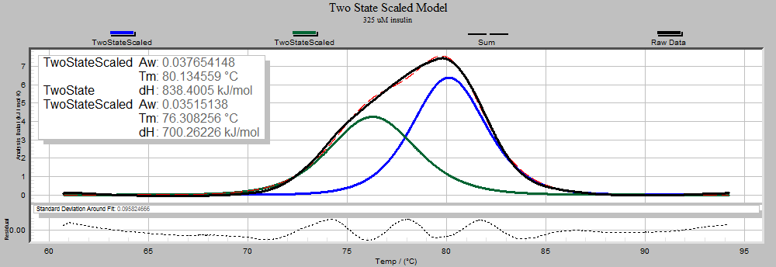
Title of poster
Authors, Stony Brook Medicine
Introduction
Methods
Results
How much text should be in the poster? If there’s too much text the readers will lose interest and move on. Limit your text to the bare minimum and give more detailed information in a handout to interested visitors. If possible use bullet points over whole paragraphs. We suggest a maximum of 800 words.
Some conferences require the introduction and conclusion to be in a larger font size than the rest of the poster. Check the conference for poster guidelines before designing.
Font sizes: Poster should be legible from 4ft away. Use your best judgment when choosing font size and style. Arial, Helvetica for title, headers and Times Roman for the body copy is recommended.
Background Color
To choose a background other than this “color” choose design menu/ background styles/format background/fill then click on desired options and apply.
Scans and digital photos
Scan images the size you want them in the poster at 200 ppi. For photos from your own digital camera, uses the largest file setting.
View your poster at 100% to see if your photos are high enough resolution.
Photos from the Internet:
Unless you find photos made for downloading and printing, the resolution is likely to be too low. The photos will print grainy when enlarged on the poster.
Use only internet photos with copyright permission. We recommend a stock photography site such as istockphoto.com or clipart.com. You will pay a small fee but have much higher quality images and copyright permission.
Background photos
We recommend not using a photo for the poster background. It could distract from the text of the poster. A textured background or gradient fill may be a better background option.
Inserting photos:
To insert a photo choose insert menu/picture
If you insert graphics from a Microsoft Office product please include a copy when sending the poster file for printing. Occasionally I have trouble with the graphics and it helps to have the original documents
Inserting Excel charts:
Select the chart in Excel. Copy it (edit menu/copy). Return to PowerPoint. Paste it. (edit menu/paste).
Caption for your photo
Conclusions
Printing as a PDF file
When finished with your poster you can get a good idea of what your poster will look like by saving it as an Adobe Acrobat file (.pdf). We can print .pdf . It will make printing easier for us, missing fonts are not as much of a problem. However we cannot alter anything once it is in that format.
Printing
Please allow 48 hours for printing. Include any graphics, images or fonts in a folder as well in case we need to re-insert anything. Call us at 444-3233 if you have further questions.
Please indicate whether you worked on a Mac or PC to design your poster.
Objectives
About backgrounds…
In the ink jet process, dark backgrounds use much more ink, are easily scratched and require longer drying time. Lighter backgrounds are encouraged.
Contrast is important. Thin lines will have to be thicker. Fonts that have thin letters might be better bold or in a sans-serif font.
If the text doesn’t stand out from the background, edit the text block to have a background color. Select the textbox then choose Format Menu / shape/fill: color. Or just put a color box behind the text.
To rearrange the white boxes in the background choose view menu/masters/slide master
To add an additional heading just copy and paste an existing heading and edit its text.
description of this figure
 | Anxiety | Depression
Physiological | -“Anxiety is so physical” -“Thought I was having a heart attack” -Rapid breathing -Sweating palms -Can’t sleep -Nausea | -Tired -Exhaustion -Loss of appetite
Cognitive | -Racing thoughts | -Downward spiral -Lack of motivation -Pessimism -Worthlessness -Suicidal thoughts
Behavioral | -Restlessness - Can’t sit still -Nail biting -Hair pulling -“You do anything to get rid of it” | -Tearfulness -Isolation -Poor personal hygiene
Affective | -Desperation -Fear -No peace -Urgency | -Sadness -Darkness -Hopelessness
Aligning text and boxes
To line up objects, select the items and choose Format Menu/Align.
Logos
If you would like to change the logo on this template for downloadable files. Please visit: https://www.stonybrookmedicine.edu/communications-toolkit/logos
References
description of this figure
Lastname, James M., & Witte, Kenneth L. (1977). Lasdkjf ;klj sdfkl jlk;jsdf lk;sjdf klj. Bulletin of the Society 12 (4), 325-328.

